Slide 1
Error Modelling of Demand Patterns to Improve Forecasting Accuracy
School of Computer Science and Engineering
Author: Sa Ziheng
Supervisor: Jagath Chandana Rajapakse

Slide 2
Research Gap + Objectives
Irregularly Structured Demand Patterns
Error Modelling
Use Residuals as Features
Study its Impact
On LSTM and Transformer
Notes:
Why is there a need for error modelling for demand forecastin?

Slide 3
Environment Setup
Python Version 3.9.7
Pytorch Version 2.0.1
GPU Tesla P100-PCIE-16GB
Random Seed = 1345

Slide 4
Experimental Flow
Select a random time series data from a dataset
Perform hyperparameter tuning for baseline LSTM and transformer networks with the chosen time series data
With the hyperparameters obtained from step 2:
conduct Experiment 1.
conduct Experiment 2.
conduct Experiment 3.
Select a random subset of time series data from the dataset
Repeat step 3 for each time series data.
Compare results between Experiments 1, 2 and 3.
Notes:
Why did i do this? First look at individual time series and fine tune our error model, toevaluate whether error modelling lead to a change in forecasting accuracy. Then we further compare the difference in accuracy with a larger sample size of 450 time series.

Slide 5
Data Description
M5-Competition dataset from Kaggle
sales_train_validation.csv (30490 x 1919 (1913))
sales_train_evaluation.csv (30490 x 1947 (1941))
calendar.csv
sell_prices.csv
Use 1913 time steps as training/ validation data and reserve 28 time steps as testing data.

Slide 6
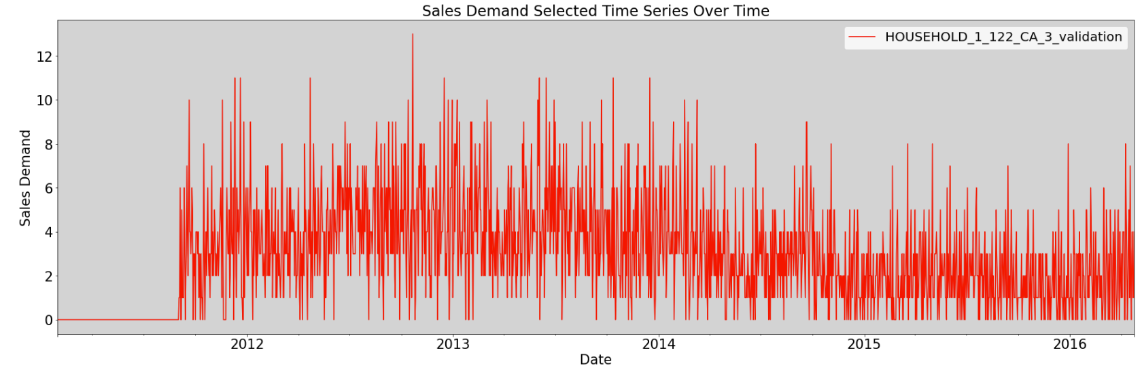
Data Selection
Select a random time series data (row 6780), which displays reasonable variability.
Select data from 1 September 2011 onwards (1698 timestamps), due to constant 0 sales from the beginning
Randomly select another 450 rows of time series data.
Notes:
450 to check the robustness of error model

Slide 7
Data Preprocessing
Min-max normalization to [-1, 1]
Convert to single-step format
Batch into data loaders

Slide 8
Hyperparameter Tuning (LSTM)
3-Fold Cross Validation, with initial hyperparameters: N= 512, L = 1, W = 28.
Batch Size (BS) | 16, 32, 64, 128, 256, 512
Hidden Neurons Number (N) | 32, 64, 128, 256, 512, 1024
Hidden Layers Number (L) | 1, 2, 3, 4, 5, 6
Window Size (W) | 7, 28, 91, 182, 364
Optimal hyperparameters: BS = 16, N = 512, L = 2, W = 91

Slide 9
Hyperparameter Tuning (Transformer)
3-Fold Cross Validation, with initial hyperparameters: N= 512, L = 1, W = 28.
dmodel | 64, 128, 512, 1024
h | 2, 4, 8
N | 2, 4, 6, 8
Batch Size (BS) | 16, 32, 64, 128, 256
Window Size (W) | 7, 28, 91, 182, 364
Optimal hyperparameters: dmodel = 64, h = 4, N = 2, BS = 32, W = 28
Notes:
D_model = the size of the hidden feature space within transformer
N= layers for encoder and decoder
h=number of heads for attention

Slide 10

Experiment 1: Baseline Models
Given 1698 time stamps available, we use 1670 days as training set and the last 28 days as validation set.
LSTM
LSTM network is trained on 1579 (1670 - 91) sets of windows and validated against the last 28 days of data.
Predict 1607 days of demand to obtain train score.
Forecast 28 days into the future with newly predicted demand continuously updated into the window to obtain test score.
Notes:
Benchmark
Train score include 1607 days of demand.
Forecast 28 days into future with the test set that we reserved earlier.

Slide 11

Experiment 1: Baseline Models
Given 1698 time stamps available, we use 1670 days as training set and the last 28 days as validation set.
Transformer
Transformer network is trained on 1642(1670 - 28) sets of windows and validate against the last 28 days of data.
Predict 1670 days of demand to obtain train score.
Forecast 28 days into the future with newly predicted demand continuously updated into the window to obtain test score.

Slide 12
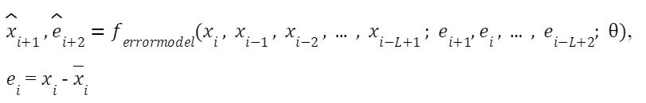
Experiment 2:
Error Models + predicted residuals
General Idea
Utilize residuals obtained from respective network models in experiment 1 and we use these residuals as feature in addition to the sales demand.
Residuals are shifted left by one time stamp.
Residuals are Min-max normalized to [-1, 1].
Notes:
Predict both residuals and sales demand

Slide 13
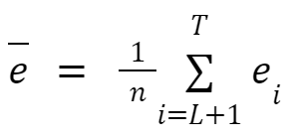
Experiment 2
Training Phase
L window is used -> first L - 1 residuals are unavailable.
Use sample mean to fill up empty values, given by the equation:

Slide 14
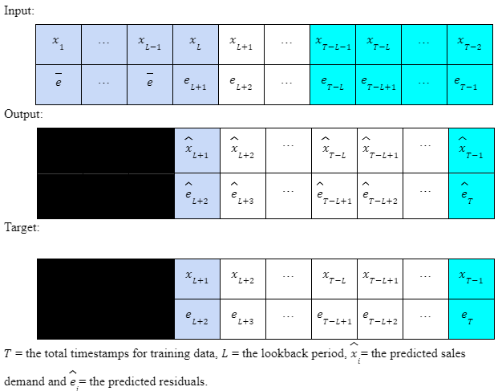
Experiment 2
T - L - 1 training/ validation data remaining instead of the original T - L training/ validation data, due to residuals being shifted left by one timestamp.
Notes:
From the diagram, we only train the data up to time point T - 1, since the residuals at time T+1 is not available for training.
Prediction of timestamp T is included in train score for sound comparison between exp 1 and 2.

Slide 15
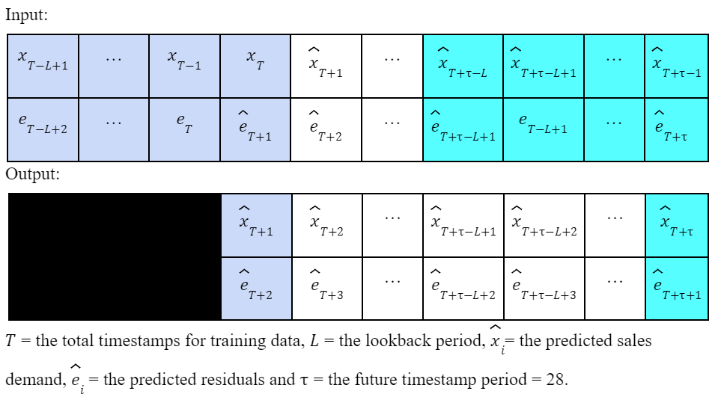
Experiment 2
Testing Phase
Newly predicted output is continuously updated into the window whenever actual sales or residuals data is unavailable.

Slide 16

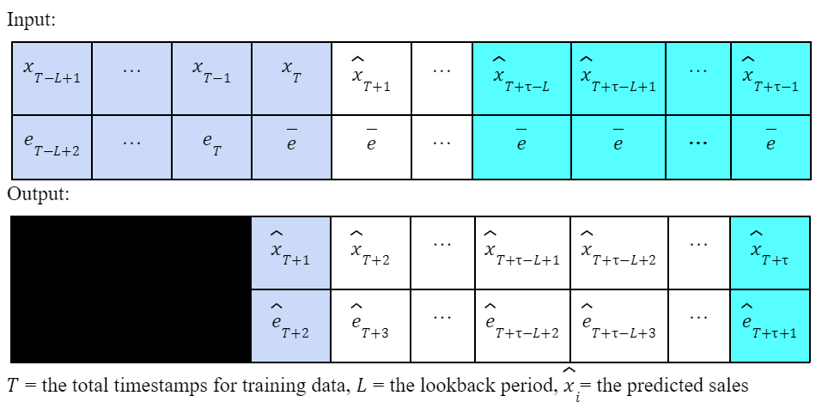
Experiment 3:
Error Models + sample mean residuals
General Idea
Training phase is the same as Experiment 2.
During testing phase, sample mean residuals instead of predicted residuals are used whenever the residual data is unavailable.

Slide 17
Analysis Method
Single-item
Visualizations and comparison between RMSE and R2 score.
450-item
Compare test statistics and confidence intervals
Paired 2-group comparison with Hotelling’s T-squared statistic with 95% confidence
Test for the null hypothesis where both evaluation metrics are the same.
Bonferroni simultaneous confidence intervals (SCIs)
Obtain the 95% simultaneous confidence interval of the difference in evaluation metrics.
Notes:
Compare whether the RMSE and R2 score between experiment 1 and experiment 2/3 differs. More interested in comparing the differences in accuracy rather than the accuracy of the model itself. —> takes into account of correlation between variables both hotelling and bonferroni

Slide 18
Summary of Test Score: 1 Item
Model | Test RMSE | Test R2
Experiment 1: LSTM | 1.60280 | -0.04464
Experiment 2: LSTM | 2.88533 | -2.38533
Experiment 3: LSTM | 2.53887 | -1.6211
Experiment 1: Transformer | 1.51024 | 0.07252
Experiment 2: Transformer | 1.50423 | 0.07989
Experiment 3: Transformer | 1.5105 | 0.07226

Slide 19
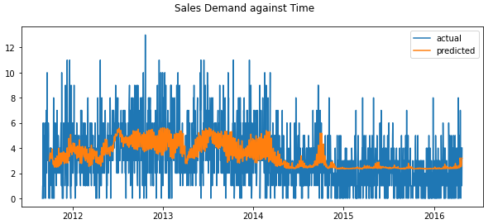
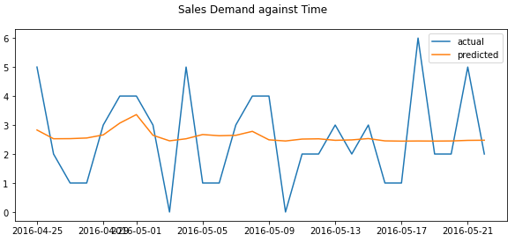
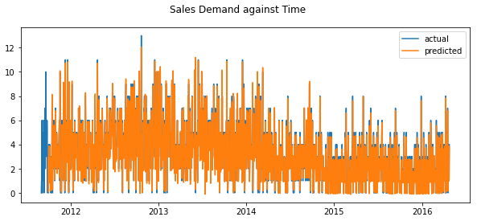
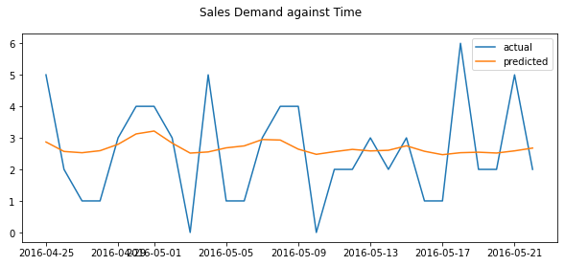
Experiment 1/2: Transformer
Experiment 1 Train Set and Test Set:
Experiment 2 Train Set and Test Set:

Slide 20
Summary of Comparison: 450-item
Basic Comparisons
Comparison | Difference in Test RMSE |  | Difference in Test R2
 | > | < | > | < | =
1. Experiment 1 - 2: LSTM | 27 | 423 | 412 | 27 | 11
2. Experiment 1 - 3: LSTM | 136 | 314 | 307 | 132 | 11
3. Experiment 1 - 2: Transformer | 131 | 319 | 313 | 126 | 11
4. Experiment 1 - 3: Transformer | 136 | 314 | 307 | 132 | 11
Notes:
So we do the comparison in the following way, where we take the eval metric from exp 1 minus the eval metric from exp 2. THen we look at the numbers that outperform experiment 1. RMSE positive, R2 negative outperform
FOr both transformer and LSTM case, we can see that more number of exp 3 that outperforms exp 1 than exp 3.

Slide 21
Summary of Comparison: 450-item
Paired 2-Group Comparison
Comparison | Null Hypothesis
1. Experiment 1 - 2: LSTM | Rejected
2. Experiment 1 - 3: LSTM | Not Rejected
3. Experiment 1 - 2: Transformer | Rejected
4. Experiment 1 - 3: Transformer | Not Rejected
Notes:
Cant really draw conclusion from this since for the case where null hypothesis is rejected, it may be either due to better or lower RMSE/ R2.

Slide 22
Summary of Comparison: 450-item
95% Bonferroni SCIs
Comparison | Difference in Test RMSE SCIs | Difference in Test R2 SCIs
1. Experiment 1 - 2: LSTM | {-1.03591, -0.65436} | {2.95151, 7.07173}
2. Experiment 1 - 3: LSTM | {-0.21150, -0.01189} | {-0.15113, 1.69016}
3. Experiment 1 - 2: Transformer | {-0.12818, -0.01858} | {0.02199, 0.20830}
4. Experiment 1 - 3: Transformer | {-0.04201, 0.02205} | {-0.03294, 0.12772}
Notes:
We can see that only the difference in experiment 1 and 3 using transformer yields both positive rmse and negative r2 in the sci, suggesting that
Also, The sci for both rmse and r2 for third row includes 0, aligns with the conclusion draw front the test statistics

Slide 23
Conclusion
Error modelling does not consistently lead to accuracy improvements.
Sample mean residuals generally serve as a better estimate than predicted residuals.
Attention-based model generally produces better results with error modelling as compared to LSTM.
Notes:
Model has hard time identifying patterns in the errors, which leads too poor residuals estimate

Slide 24
Limitations
Same hyperparameters for different time series data
Choice of time series models
Notes:
Same hyperparameters used for different time series data, which hinders the perf of baseline model and constrain the performance of error model.
Choice of time series models.

Slide 25
Future Improvements
Obtain optimal hyperparameters for each time series data
Optuna
Hyperopt
Bayesian optimization
Choice of time series models
Informer
Autoformer
Include noise in residuals feature to prevent overfitting
Notes:
Unpredictability of error patterns
Same hyperparameters used for different time series data, which hinders the perf of baseline model and constrain the performance of error model.
Choice of time series models.

Slide 26
Thank You

